Slide 1
Predictive Maintenance of Industrial Machinery
CAPSTONE PROJECT
Presented By:
Thanvi S Shetty-Maharaja Institute of technology- Computer Science Artificial Intelligence

Slide 2
OUTLINE
Problem Statement Proposed System/Solution
System Development Approach
Algorithm & Deployment
Result
Conclusion
Future Scope
References

Slide 3
Problem Statement
Develop a predictive maintenance model for a fleet of industrial machines to anticipate failures before they occur. This project will involve analyzing sensor data from machinery to identify patterns that precede a failure. The goal is to create a classification model that can predict the type of failure (e.g., tool wear, heat dissipation, power failure) based on real-time operational data. This will enable proactive maintenance, reducing downtime and operational costs.

Slide 4
Proposed Solution
The proposed system aims to predict the Failure Type of industrial machinery using historical sensor data. This includes developing a predictive model using supervised machine learning techniques.
Key steps:
Data Collection: Use sensor data including temperature, rotational speed, torque, and tool wear.
Data Preprocessing: Handle missing values, normalize input features, and encode categorical variables.
Model Building: Train and evaluate multiple machine learning pipelines.
Optimization: Use cross-validation and hyperparameter tuning to optimize model accuracy.
Deployment: Deploy the best-performing model via IBM Watsonx for real-time prediction

Slide 5
System Approach
Platform Used: IBM Watsonx.ai Studio
Data Split: 90% training and 10% holdout data
Approach: AutoAI pipeline generation and evaluation
Model Selection: Snap Random Forest Classifier & Snap Decision Tree Classifier

Slide 6
Algorithm & Deployment
Algorithm Selection:
Random Forest & Decision Tree Classifiers
Best model: Batched Tree Ensemble Classifier with accuracy: 0.995
Training Process:
IBM AutoAI generated 9 pipelines
Hyperparameter optimization and feature engineering applied
Deployment:
Best pipeline (Pipeline 5) deployed
Real-time prediction enabled via Watsonx's API interface

Slide 7
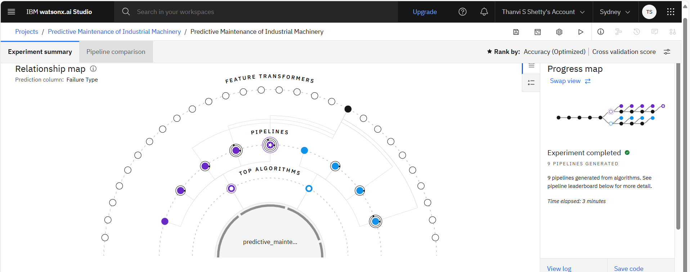
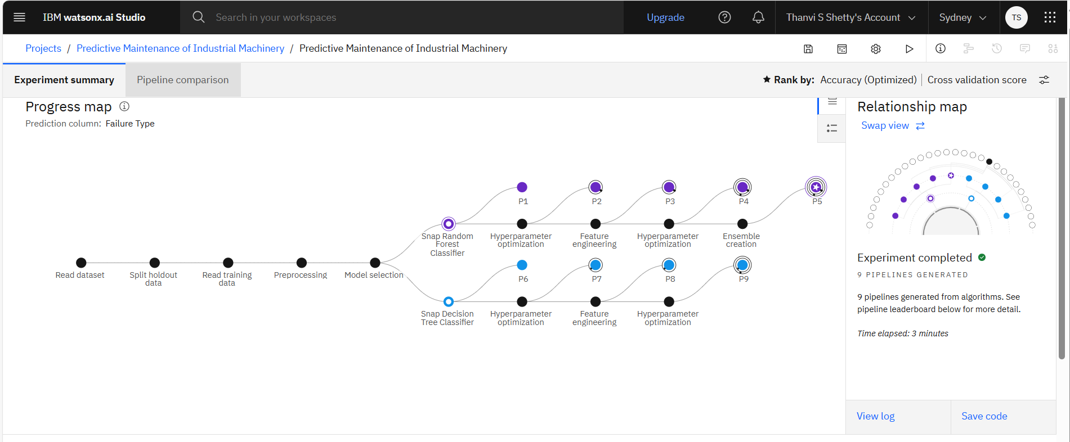
Result
Model used: Pipeline 5 – Batched Tree Ensemble Classifier
Accuracy: 99.5% (Cross-validation)
Output: Multiclass classification — Predicts "Failure Type" with 100% confidence

Slide 8
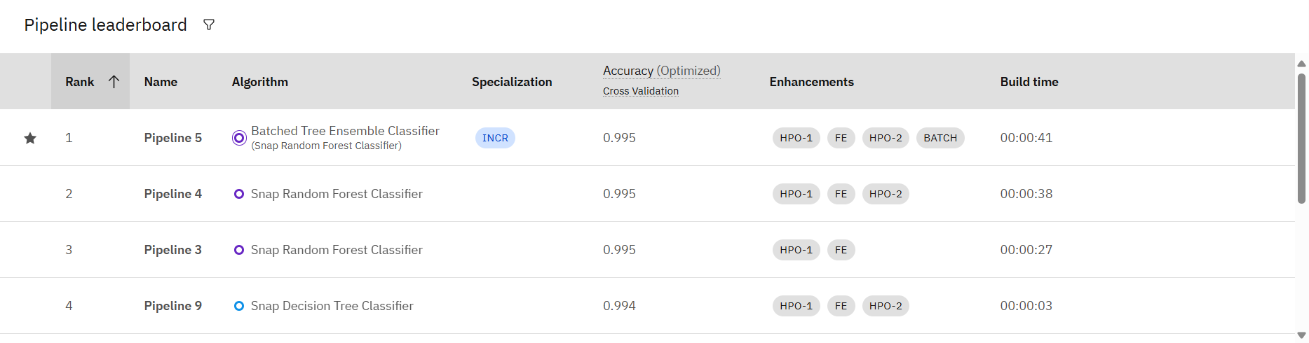
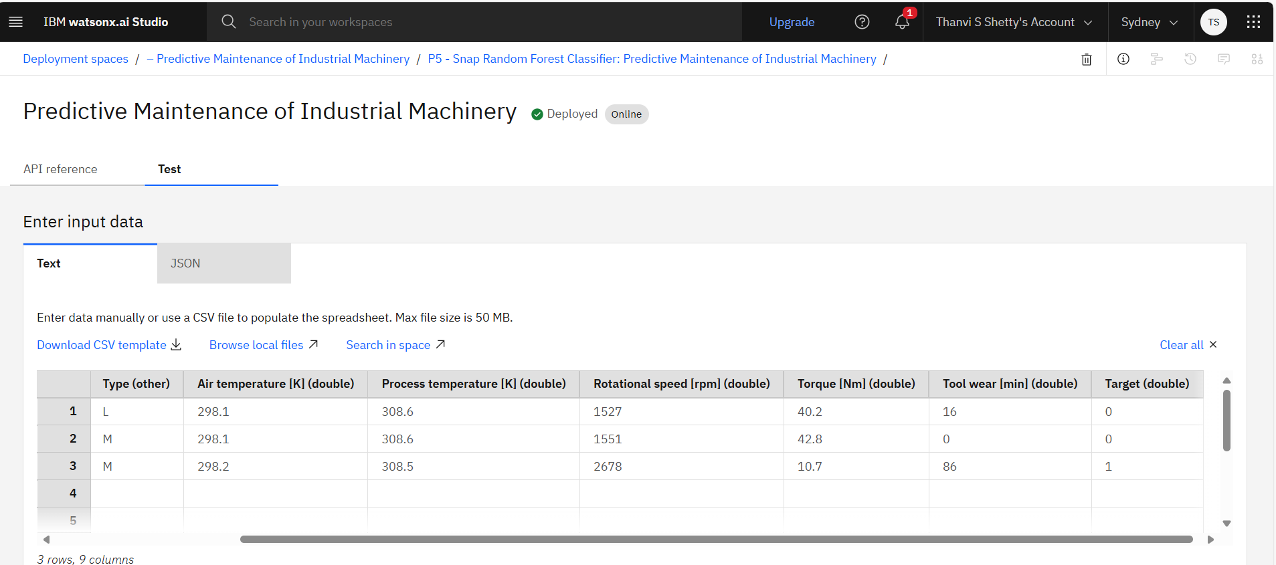
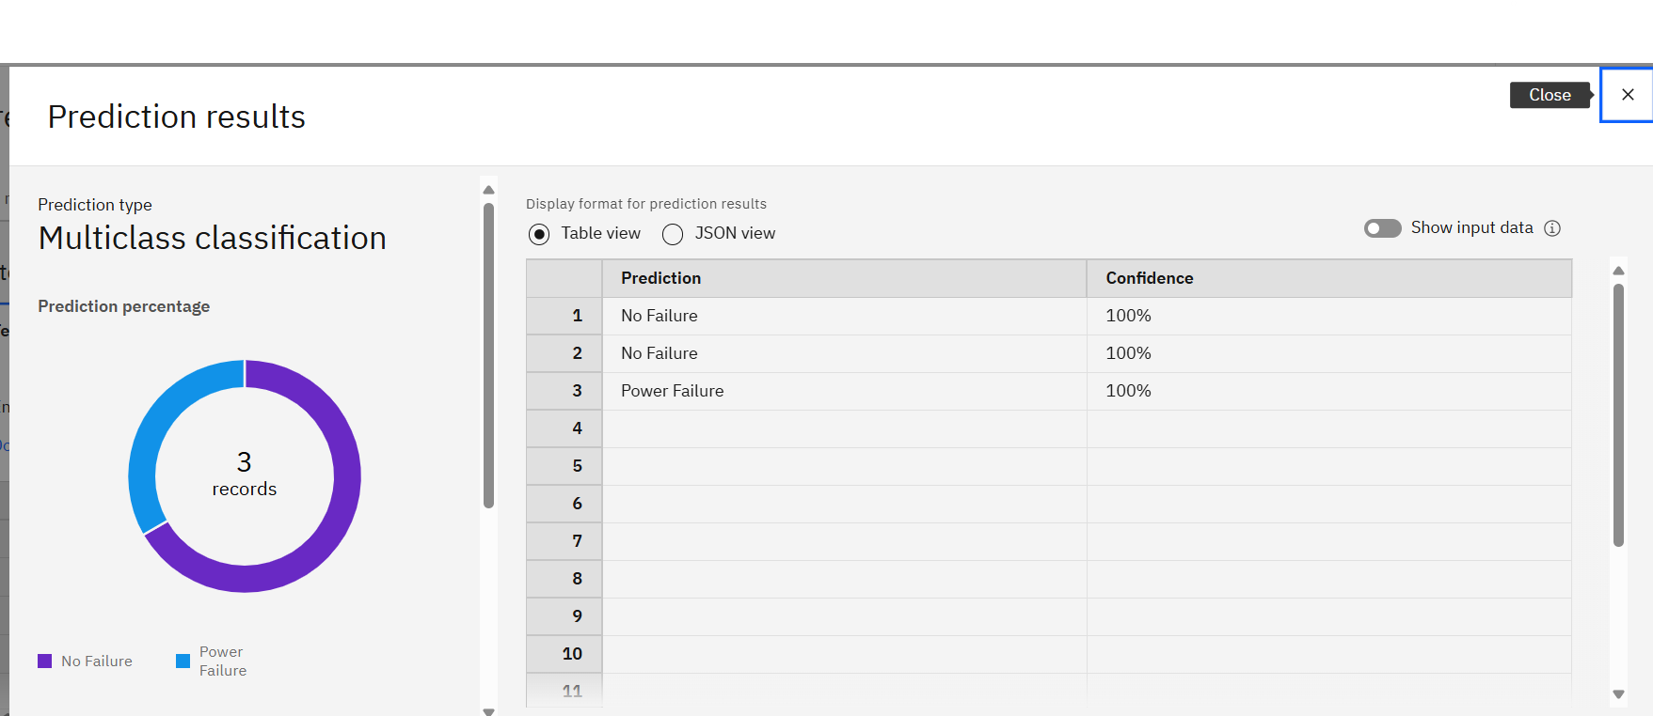
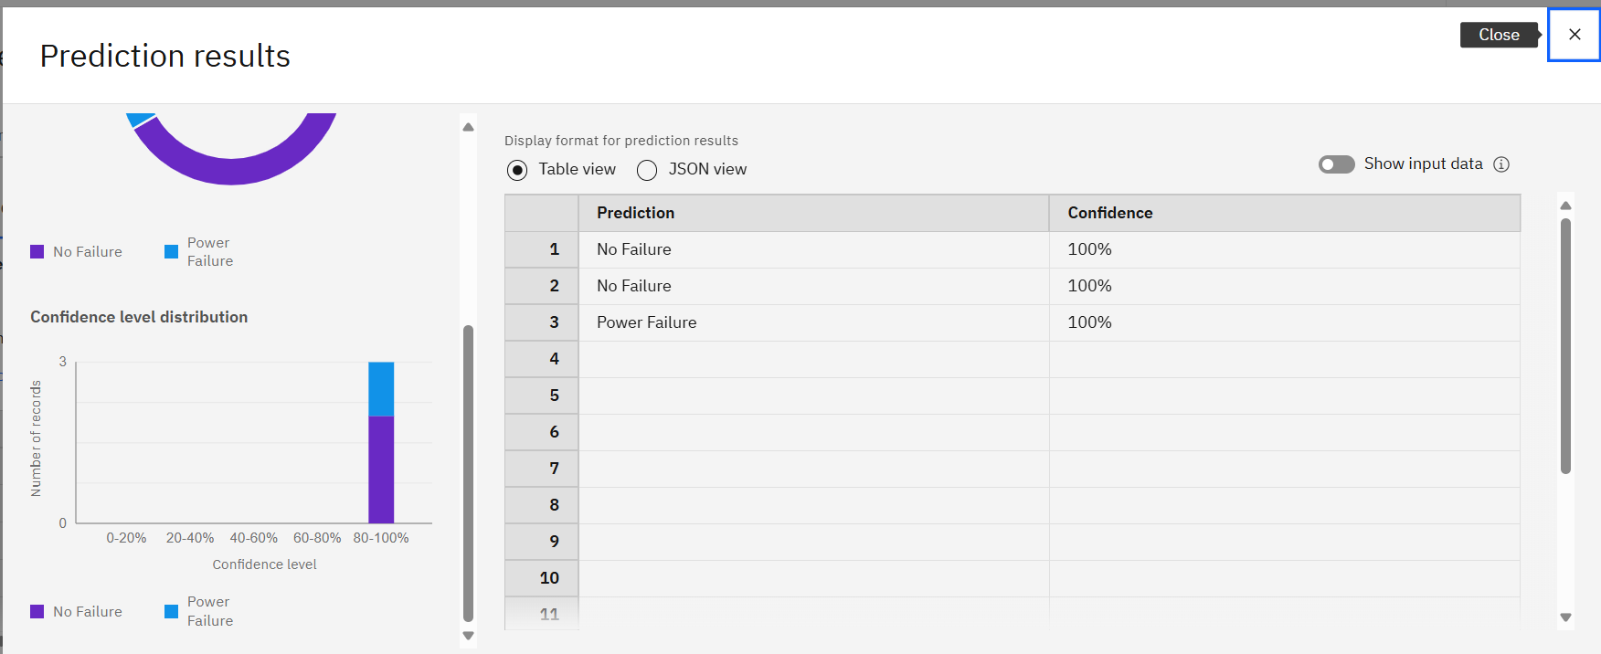

Slide 9
Conclusion
The project successfully implemented a machine learning solution to predict machinery failures with high accuracy using Watsonx.ai. The system helps reduce downtime and improve production efficiency by enabling preventive maintenance actions.

Slide 10
Future scope
.
Apply deep learning for better fault classification
Extend the system to multiple factory environments
Visualize predictions on dashboards for easier decision-making
Integrate more real-time IoT sensor data

Slide 11
References
IBM Watsonx.ai service documentation
Research papers on predictive maintenance and AutoML
Tutorials on Random Forest and Decision Tree classifiers

Slide 12
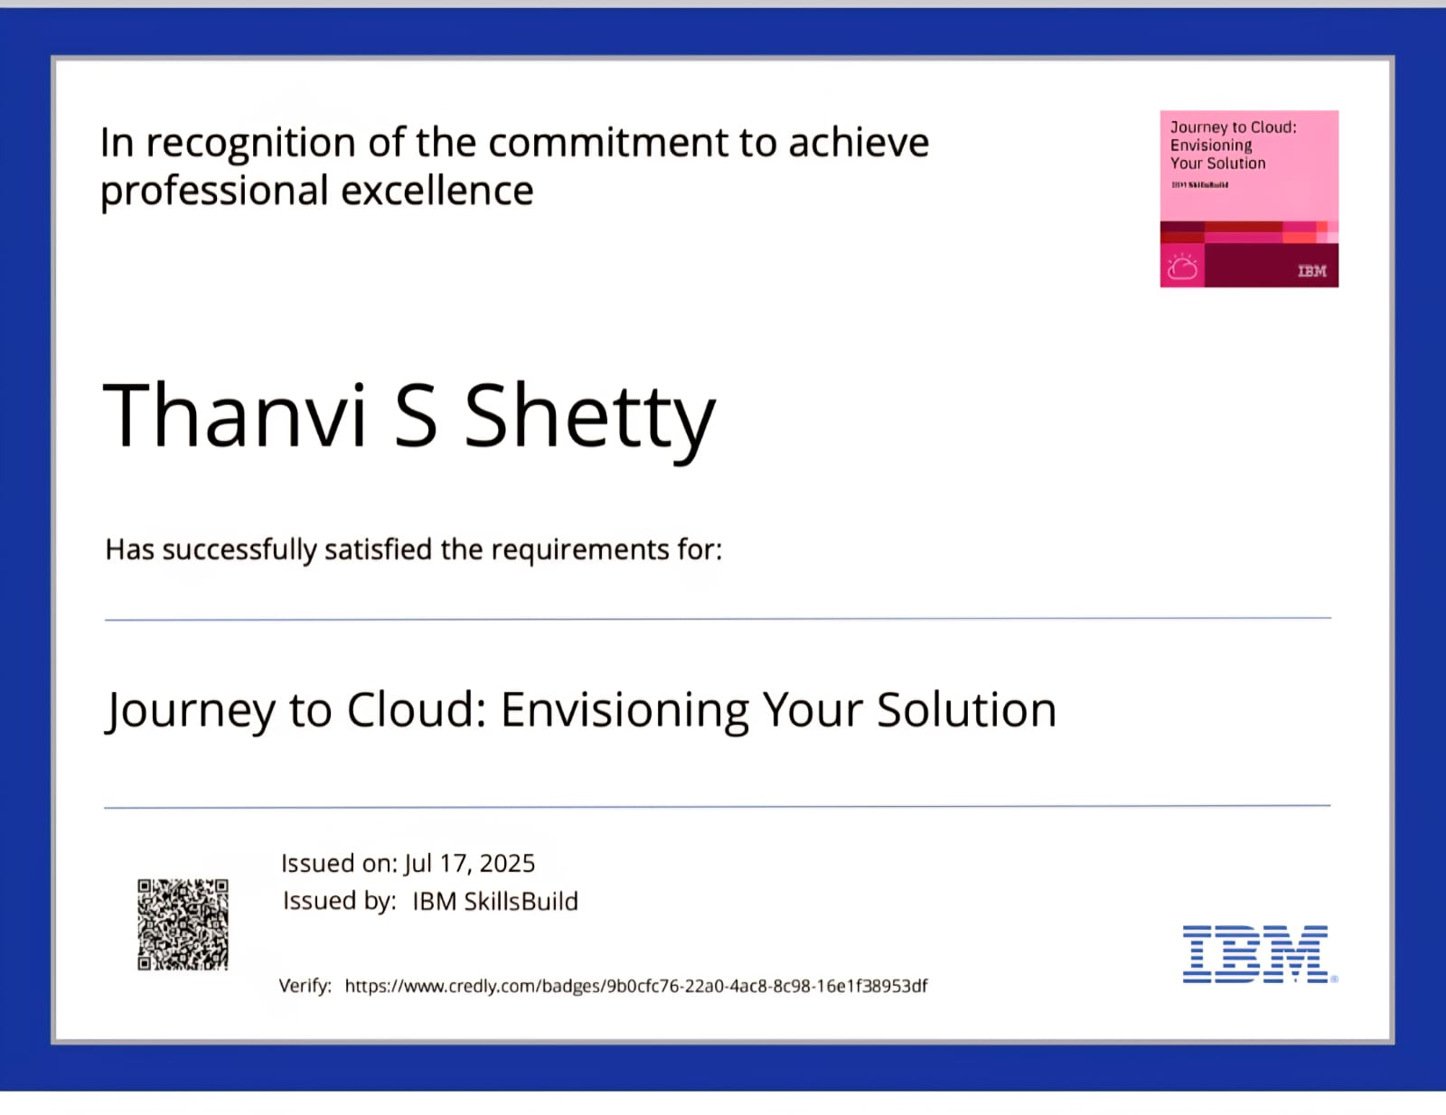
IBM Certifications

Slide 13
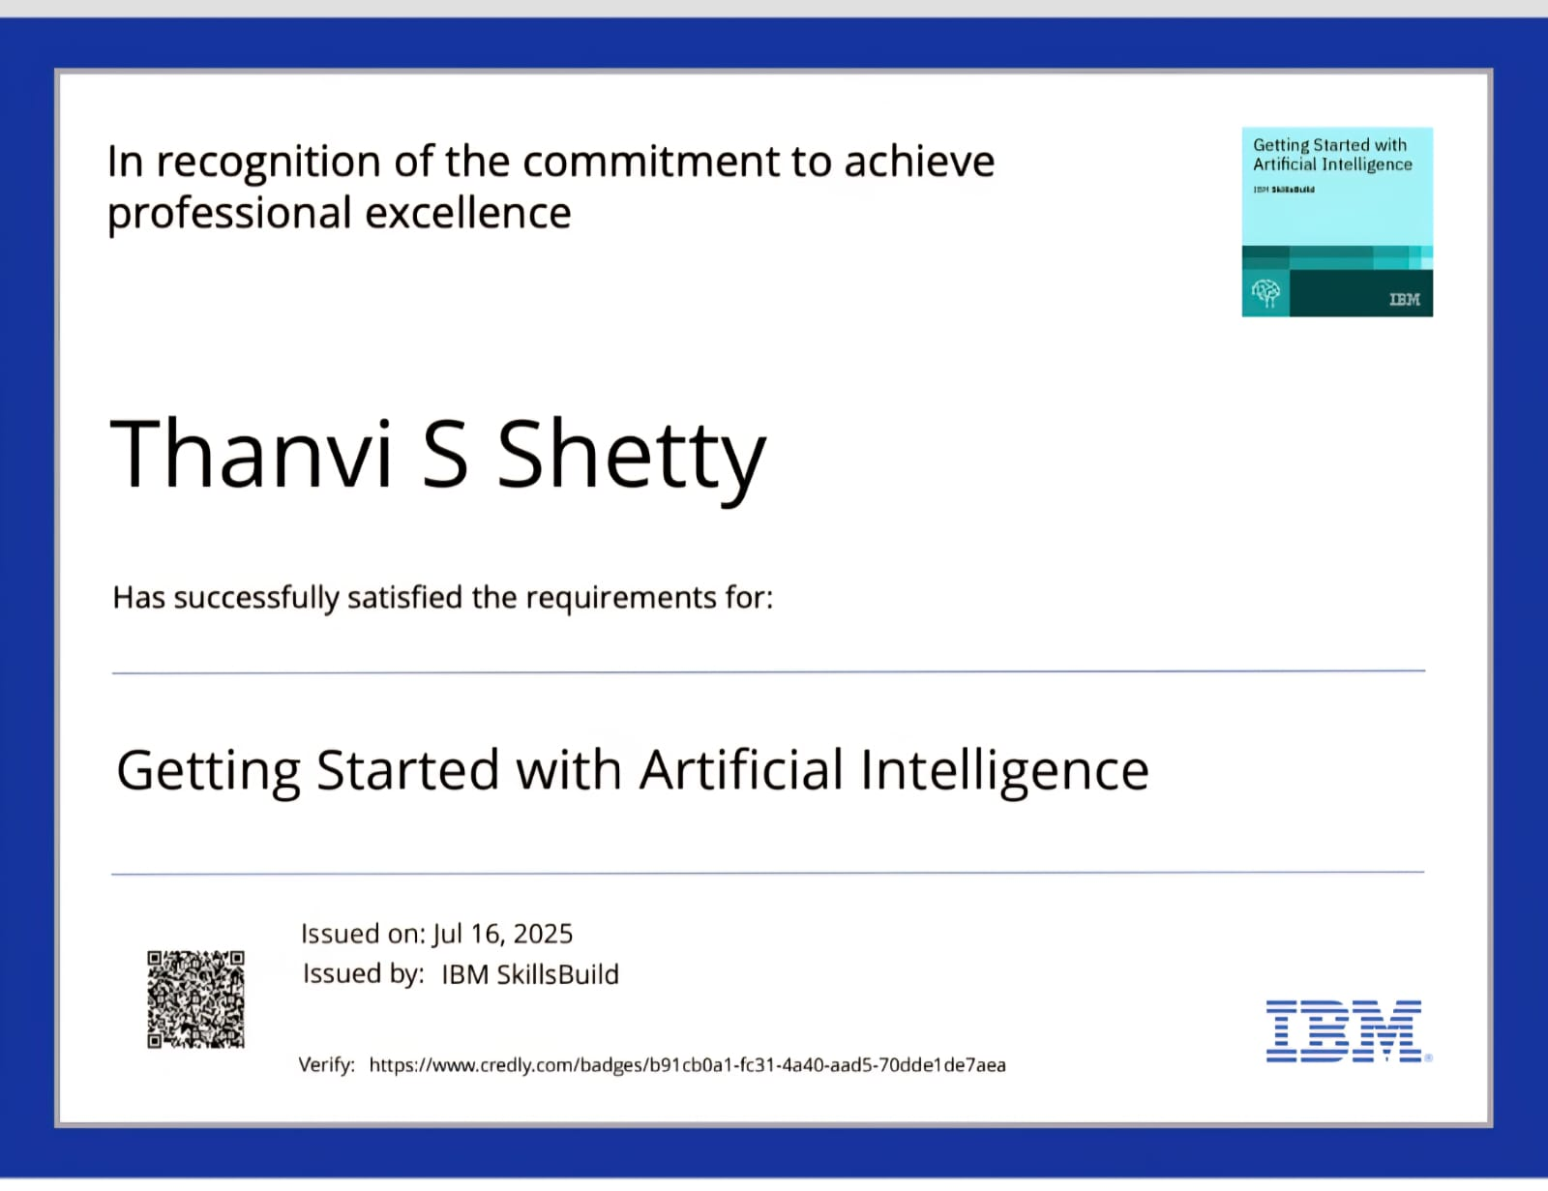
IBM Certifications

Slide 14
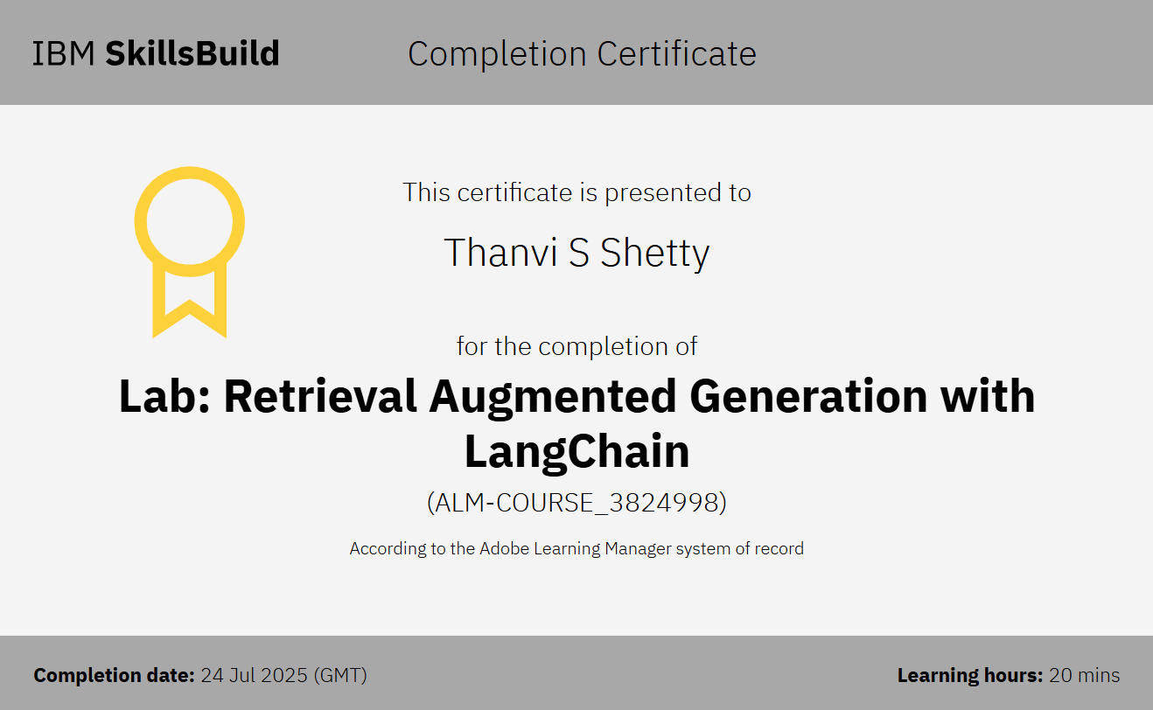
IBM Certifications

Slide 15
THANK YOU

